Slide 1
OOPs in Python

Slide 2

Index
OOPs in Python
• Polymorphism
• Introduction
• Creating Polymorphic Classes
• Polymorphism with Class methods
• Polymorphism with Functions

Slide 3
Polymorphism
Introduction:
· Polymorphism is an object-oriented programming concept that refers to the ability of a variable, function or object to take on multiple forms.
· A language that features polymorphism allows developers to program in the general rather than program in the specific.
· Polymorphism can be carried out through inheritance, with subclasses making use of base class methods or overriding them.
· Polymorphism allows for flexibility and loose coupling so that code can be extended and easily maintained over time.

Slide 4
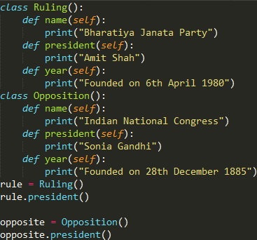
Polymorphism
Creating polymorphic classes:
· Create two distinct classes to use with two distinct objects.
· These distinct classes need to have an interface that is in common so that they can be used.
· Make different methods with same name in two classes.
Example:

Slide 5

Polymorphism
· In the example we created two classes with three methods which are same in both classes , but there functionality is different.
· We instantiated these classes to two objects and same method from both the classes is called.
· It will give output as both president names.
· We can use the two objects in the same way regardless of their individual types.

Slide 6
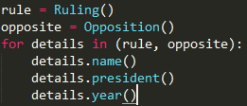
Polymorphism
Polymorphism with class methods:
· To show how Python can use each of these different class types in the same way, we can first create a for loop that iterates through a tuple of objects.
· We can call the methods without being concerned about which class type each object is and we assume these methods exist in each class.
Example:
· we have two objects rule , opposite and for to iterate over methods in the class.

Slide 7
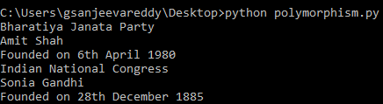
Polymorphism
Example:
· First for loop iterates through rule object of Ruling class and then to Opposition class, so the methods of Ruling are executed first .
· By this python is using these methods in a way without considering what class type each of these objects is.

Slide 8
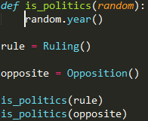

Polymorphism
Polymorphism with functions:
· Create a function that can take any object for polymorphism.
· is_politics() is the function and random which takes in the objects.
Example:
· In the example we created a function called is_politics() and random to take the object which are called.
· We will give some functionality to do that uses random object we passed to it i.e, year() method ,which is defined in both classes.

Slide 9
Polymorphism
Example:
· We will create instantiations of both classes with these we can call their action using same is_politics().
· Finally, though we passed a random object (random) into the is_politics() function when defining it, we were still able to use it effectively for instantiations of the Ruling and Opposition classes.
· The rule called the year() method defined in the Ruling class, and the opposite object called the year() method defined in the Opposition class.
Note: Without using polymorphism, a type check may be required before performing an action on an object to determine the correct method to call.

